Slide 1

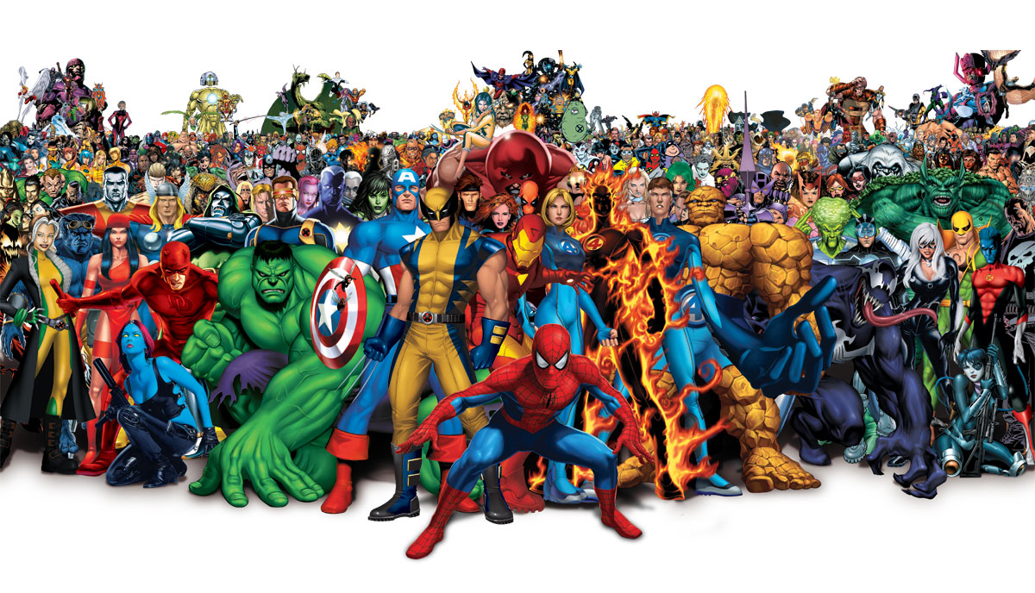
Are you related to a super hero?
ancestry.com

Slide 2
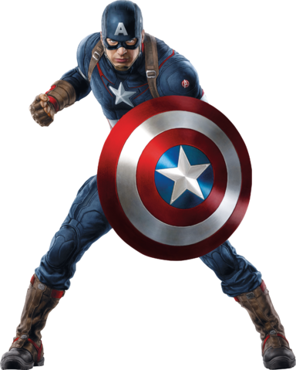
Application concept
Could you be related to a super hero?
Upload your photo to compare to an array of super hero photos.
The application will return the match with the highest probability, along with a brief description of the hero.
Searches are dated and stored and available for review.

Slide 3
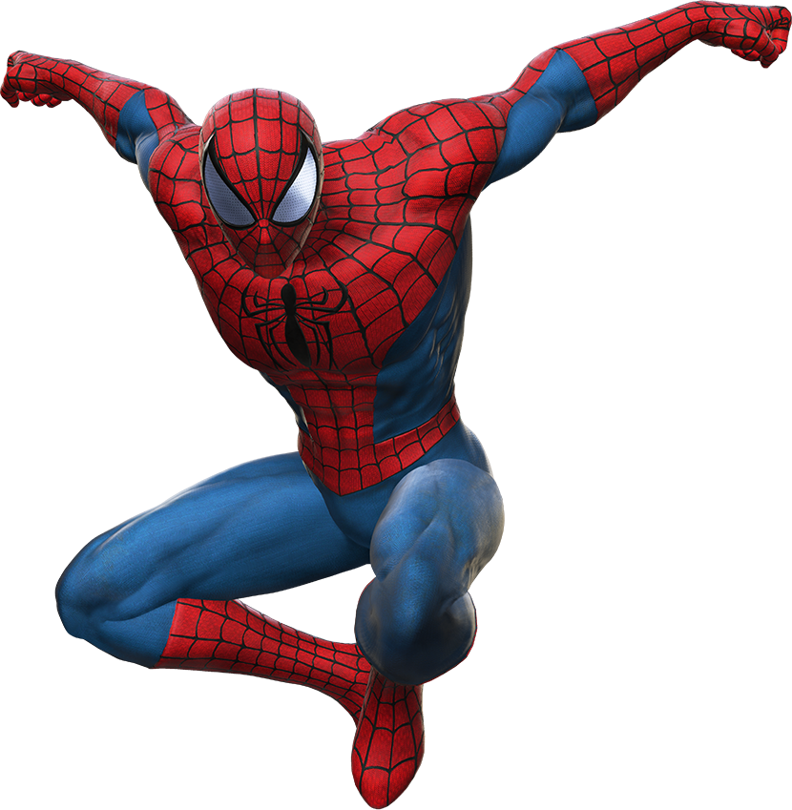
Why do this?
We wanted to find a fun way to interact with facial recognition software.
Facial recognition is cutting edge technology that is becoming more prevalent in society.
We wanted to take this opportunity to learn what we could to establish a baseline understanding.

Slide 4
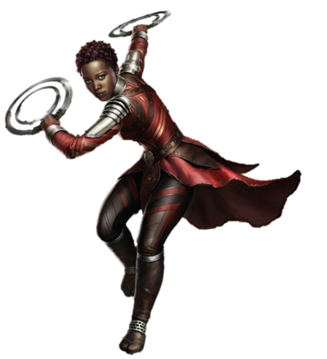
Design process
We started with very high level concepts of different ideas, and talked through how we could make each idea work. After throwing out some ideas, we settled on an idea to pursue.
Each team member spent time researching various APIs to determine if this idea was feasible for this assignment, given the time constraints.
After deciding we would persevere, we set the guidelines for a minimal viable product. We listed APIs we would use, thought of how we would utilize Firebase, what repeating element to use.
We wrote user stories in GitHub, and created a Kanban board. Then each member assigned themselves some stories to work on. As we completed the stories, we closed and moved them to ‘Done’. We created additional user stories for gaps that were identified throughout the process.

Slide 5
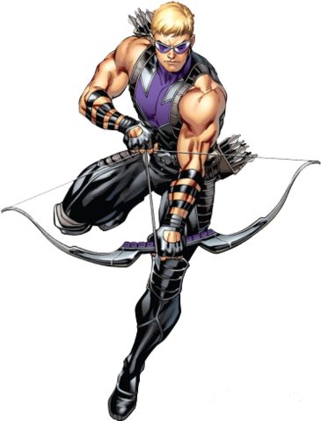
technologies
APIs: Face++, Marvel
Database: Firebase
CSS Framework: Bootstrap
JQuery/Javascript
Google fonts

Slide 6
Work breakdown
Sam R
Concept creator
Face++ leader
Developed the initial wireframe
Sam M
HTML/CSS improvements
Marvel API research
Shadow box library
Kevin
Firebase implementation
Marvel API implementation
User stories/Kanban board
We backed each other up.

Slide 7
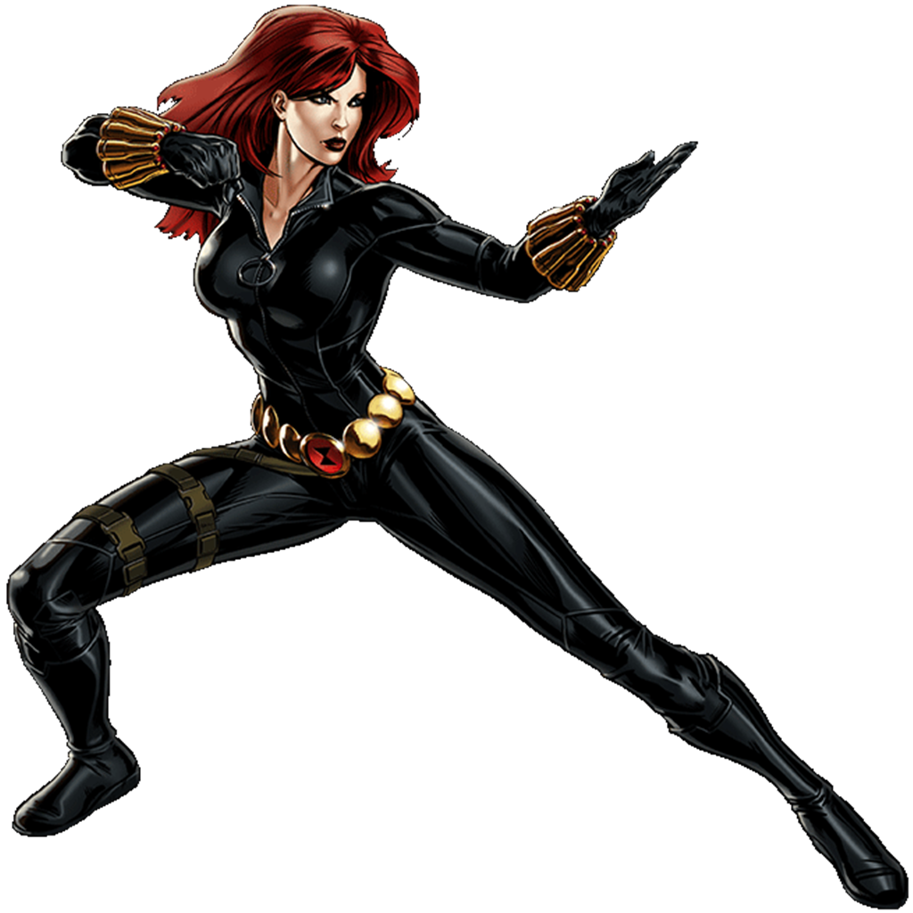
demonstration

Slide 8
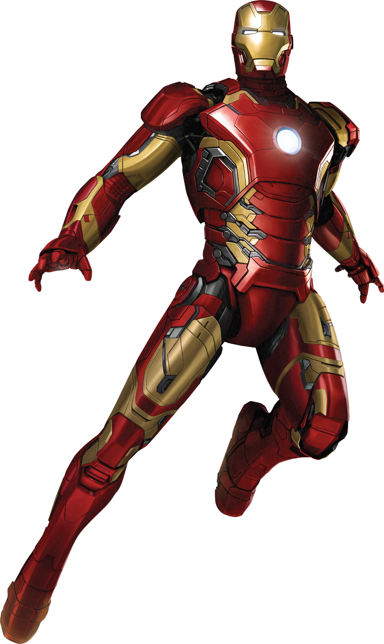
The future
Since our MVP shifted throughout the project, the following items are on the improvements list:
Compare faces with user uploaded photo
Expand the number of super heroes in the comparison array
Add a carousel to the page, possibly displaying uploaded photos and/or super heroes
Add face merging

Slide 9
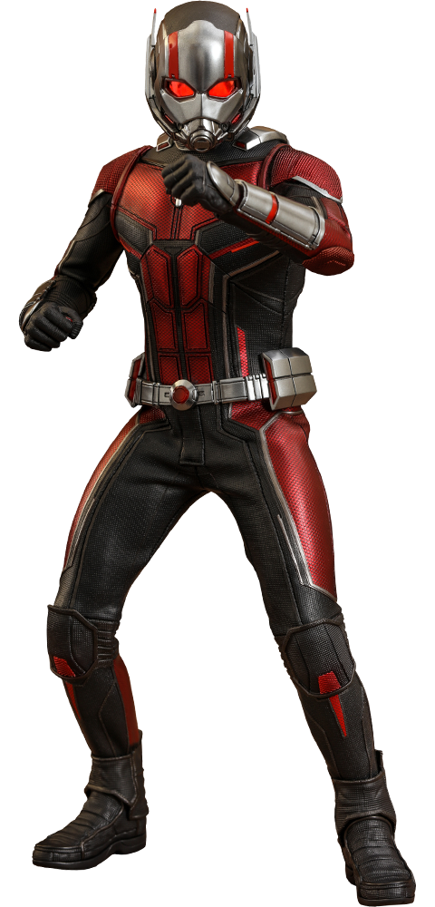
Questions

